Slide 1
Logistic Regression with R
Anukriti Gupta
10/16/2019

Slide 2

What is Machine Learning?

Slide 3
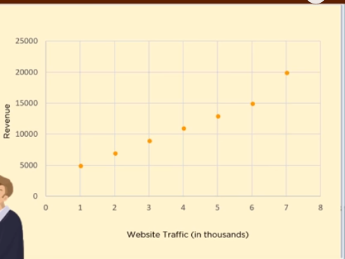
Why Regression?
We need to predict the revenue based on the website traffic
13000
4.5?

Slide 4
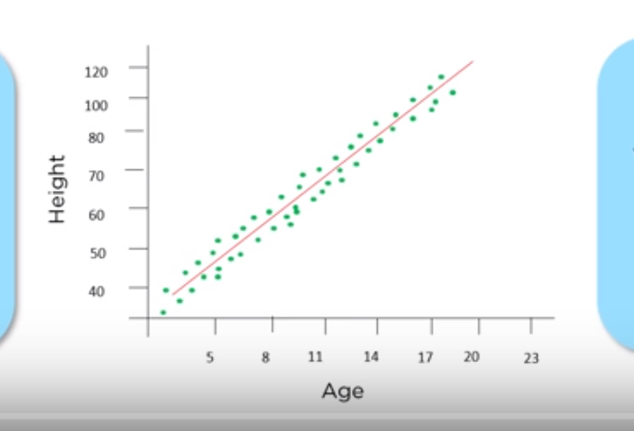
What is Regression?
A statistical relationship between two or more variables where a change in independent variable is associated with a change in dependent variable
Here, the change in one variable (height) is closely associated with change in another variable (age)
We see that the height is the dependent variable and age is the independent variable

Slide 5
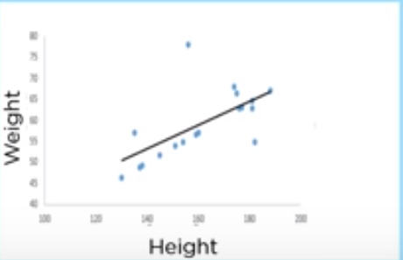
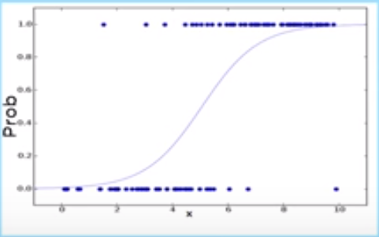
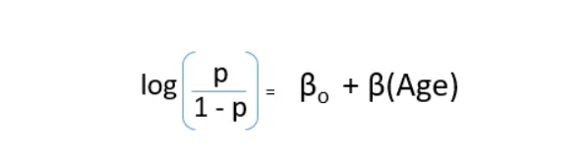
Types of Regression
Linear Regression
When there is a linear relationship between a dependent variable (continuous) and an independent variable (continuous or discrete)
Logistic Regression
When the Y value in graph is categorical in nature i.e., Yes/No and depends on the X variable

Slide 6
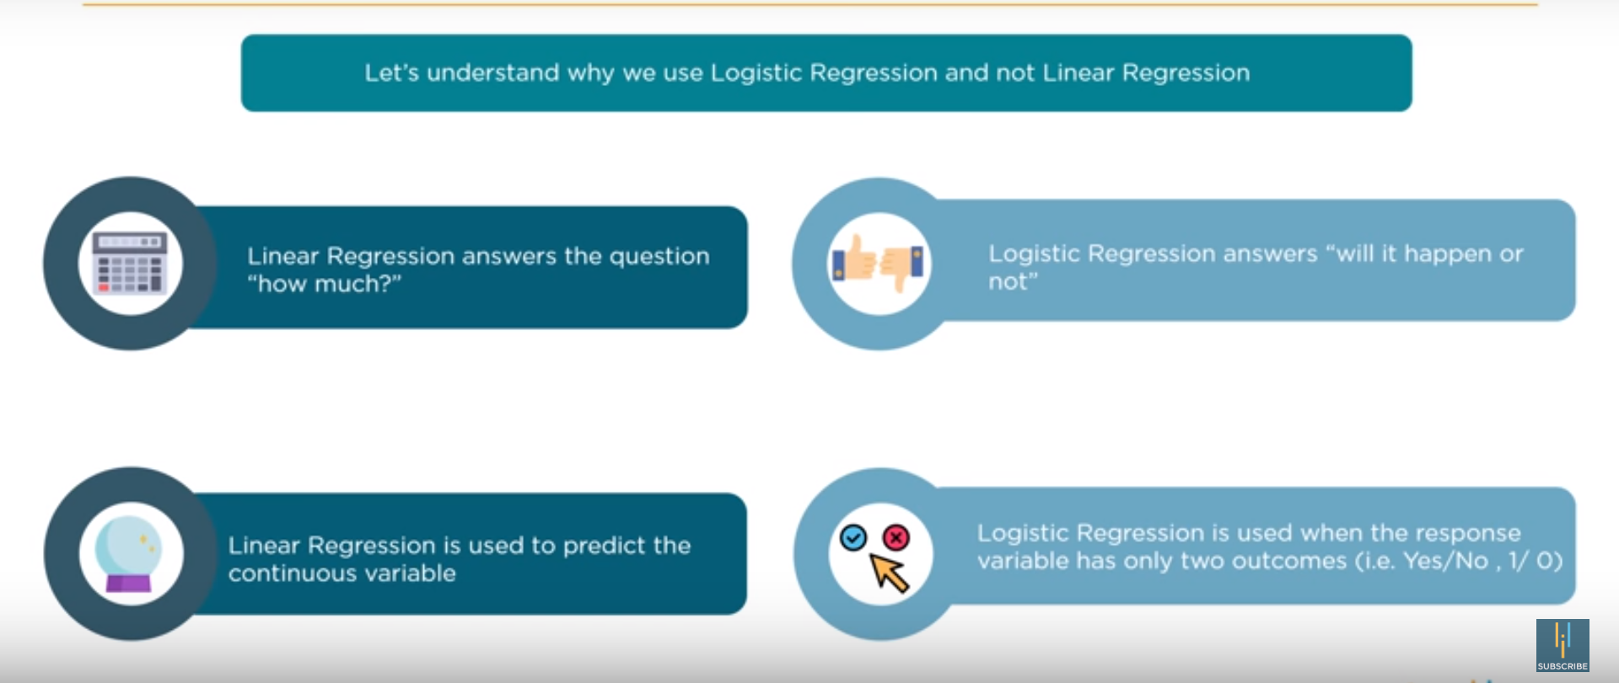
Why Logistic Regression?

Slide 7
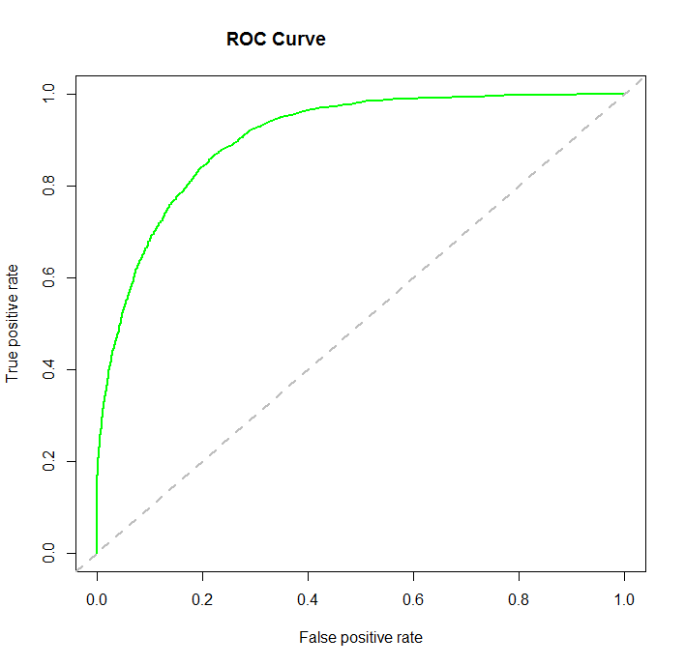
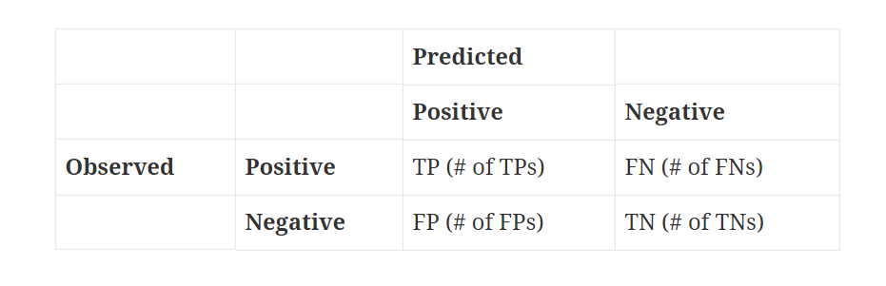
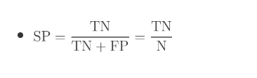
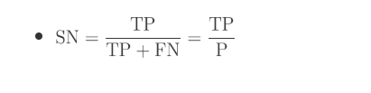
ROC Curve

